Slide 1
Simulation Study of a STATCOM for Reactive Power and Harmonics Compensation

Slide 2
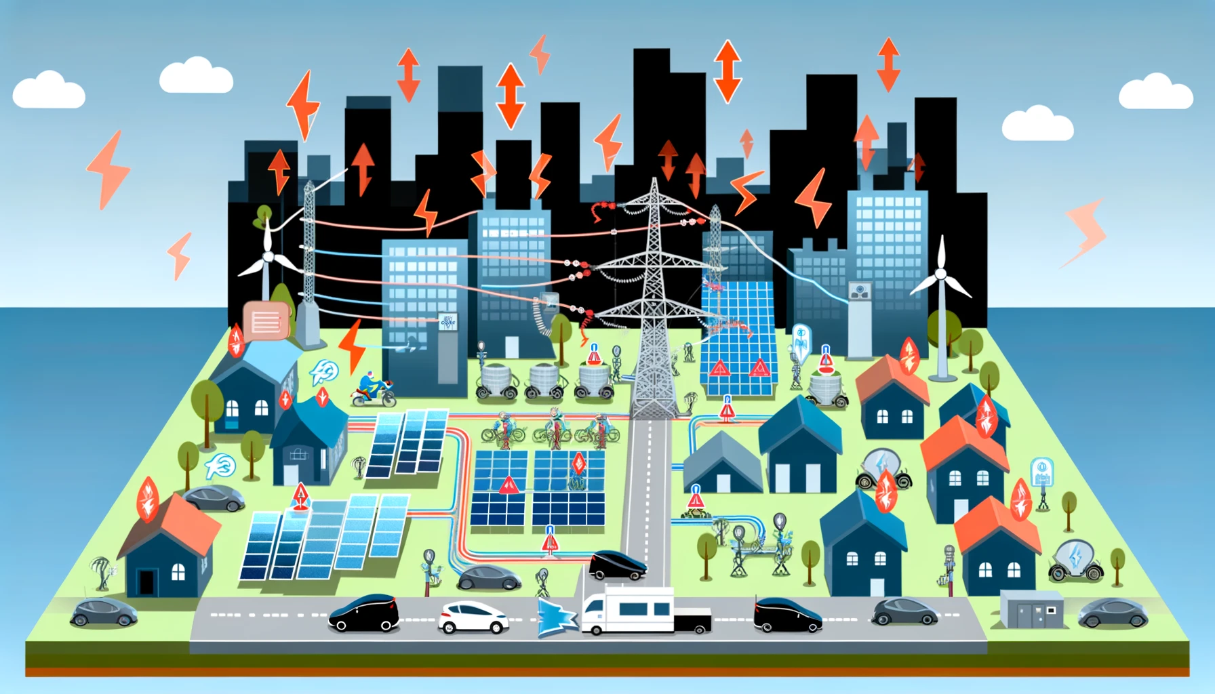
Challenges for Modern Electricity Grids
Main challenge:
Modern electricity grids are becoming congested due to new types of loads and growing populations.
Increased Power Demand:
Residential and Commercial Electricity Use
Electric Vehicles
Smart Devices and Appliances
Integration of Renewable Energy:
Distributed Energy Resources
Bidirectional Flow
Industrial and Technological Development:
Data Centers
High-Power Industrial Equipment

Slide 3
One possible Solution: increase the amount of real power from grid
STATCOM can do!

Slide 4
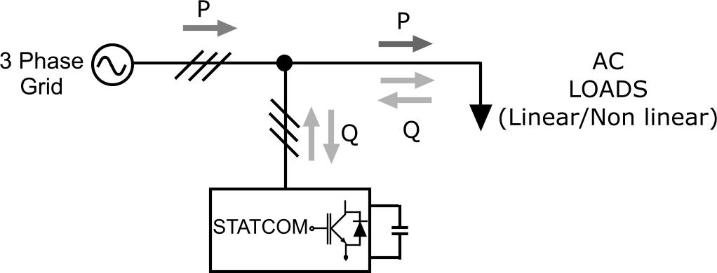
What is the function of STATCOM?
STATCOM can supply or absorb reactive power into or from the power grid

Slide 5
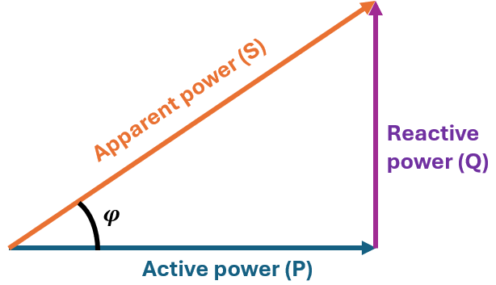

What is the function of STATCOM?
STATCOM can increase the power factor of the grid to 1
$$Power factor=\frac{Active power (P)}{Apparent power (S)}$$

Slide 6


What is the process of the whole project?
Three phase inverter
$$↓$$
STATCOM with linear load
$$↓$$
STATCOM with non-linear load
Stretch goal:

Slide 7
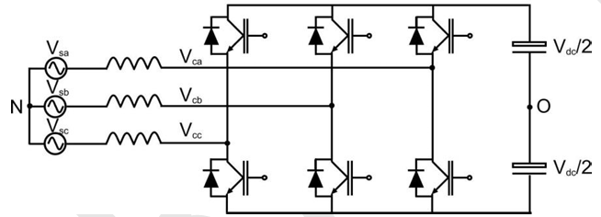
Three-phase inverter
Function:
Convert DC current into three phase AC current.
Two-level converter:
Power Switches Three half bridges, each phase uses two switches that connect to the positive and negative of the DC supply.
Operation: By switching quickly in a controlled sequence, the inverter generates a stepped waveform that approximates an AC waveform.
PWM: The PWM controls the duty cycle of the switch to generate an AC output voltage that approximates the sine wave.

Slide 8
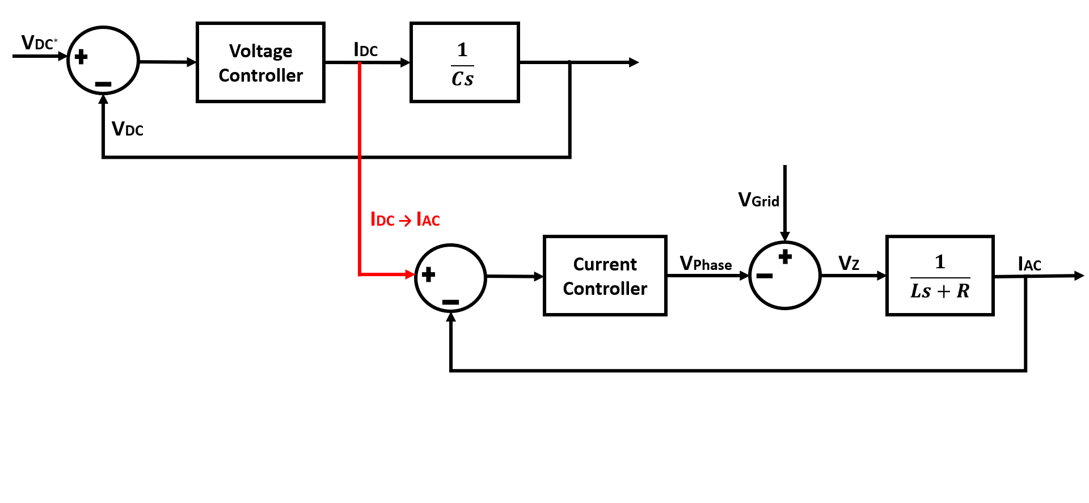
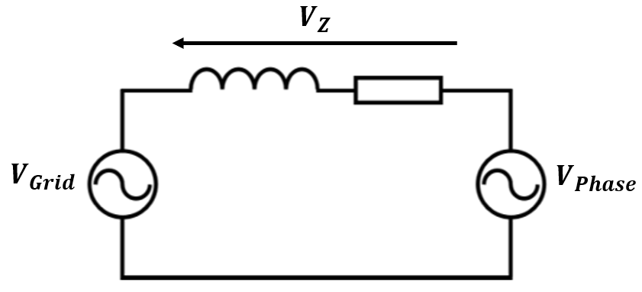
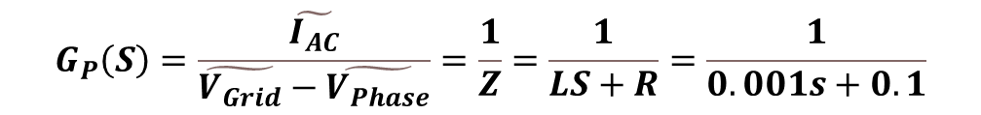
Three-phase inverter
Voltage controller and current controller:
Laplace transform
Block diagram
Deriving transfer function
$$G_{P}\left(S\right)=\frac{\tilde{I_{AC}}}{\tilde{V_{Grid}}−\tilde{V_{Phase}}}=\frac{1}{Z}=\frac{1}{LS+R}=\frac{1}{0.001s+0.1}$$

Slide 9
Three-phase inverter
Verification:
Transfer function verification in MATLAB
Current controller verification
Voltage controller verification
Ripple verification
Deliverables
Current controller
Voltage controller
The three phase inverter

Slide 10
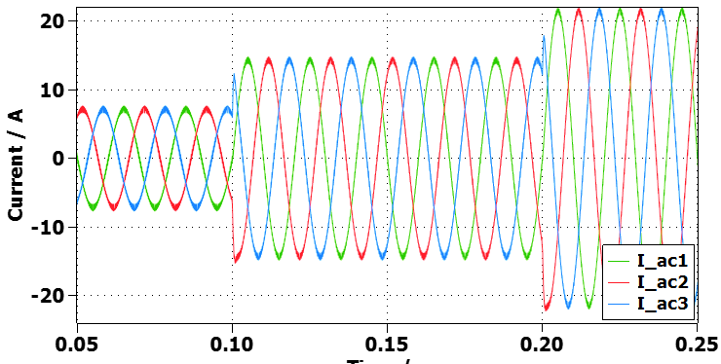
Switch - The key to verification
Current controller in each phase:

Slide 11
STATCOM with linear load

Slide 12
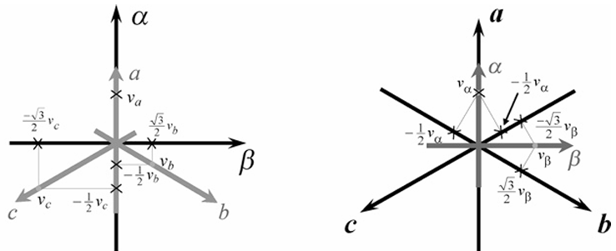
STATCOM with linear load
Reactive power compensation algorithms:
P-Q theory
Clark transform
(Clark transform)
(inverse Clark transform)

Slide 13
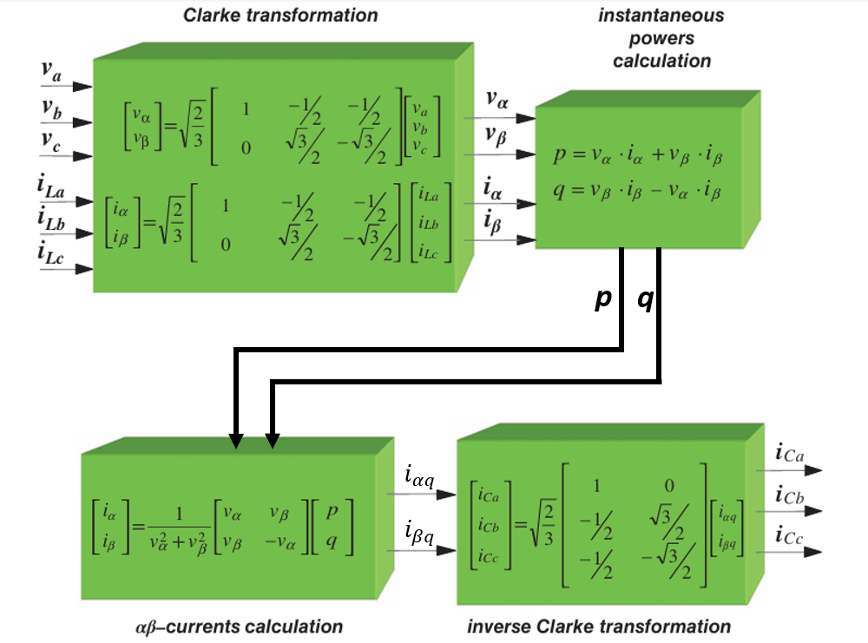
STATCOM with linear load
Verification:
Reactive power compensation verification
Current controller verification
Voltage controller verification
Algorithm:
Deliverables:
Model the STATCOM as an ideal voltage source.
Fully controlled 3 phase STATCOM with linear load

Slide 14
Modelling the STATCOM as an ideal voltage source

Slide 15
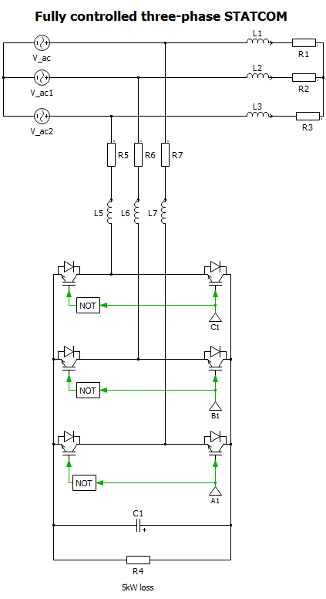
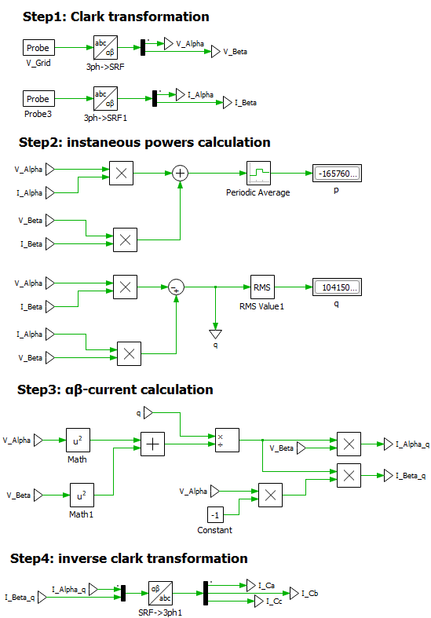
Fully controlled 3 phase STATCOM with linear load

Slide 16
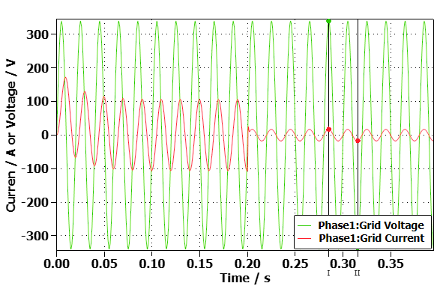
Switch - The key to verification

Slide 17
Stretch goal: STATCOM with non-linear load

Slide 18
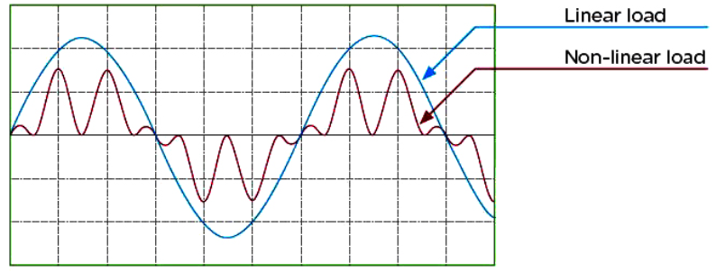
Stretch goal: STATCOM with non-linear load
Characteristics of nonlinear loads：
The voltage is not proportional to the current.
Harmonic currents

Slide 19
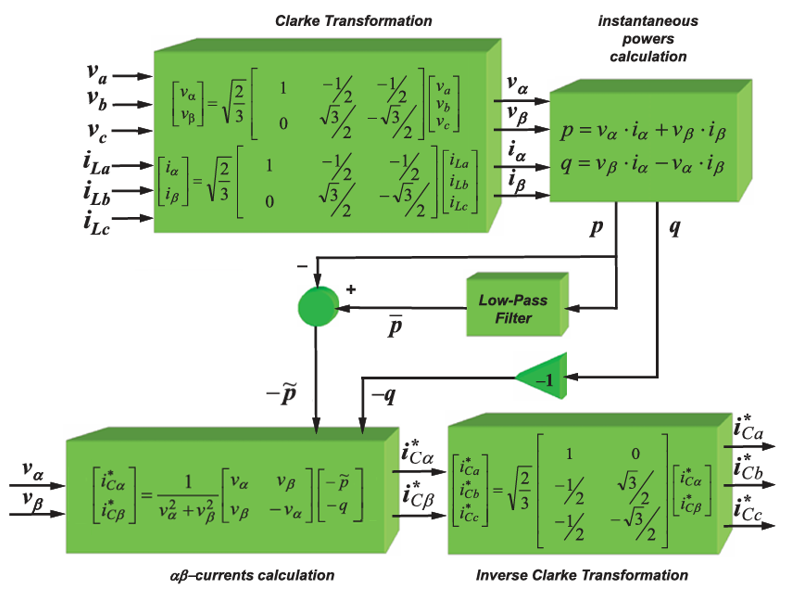
Stretch goal: STATCOM with non-linear load
Verification:
5-order Butterworth low pass filter verification
Current controller verification
Voltage controller verification
Reactive power compensation verification
Harmonics compensation verification
Deliverables
Fully controlled 3 phase STATCOM with non-linear load.

Slide 20
Fully controlled 3 phase STATCOM with non-linear load

Slide 21
Switch - The key to verification

Slide 22
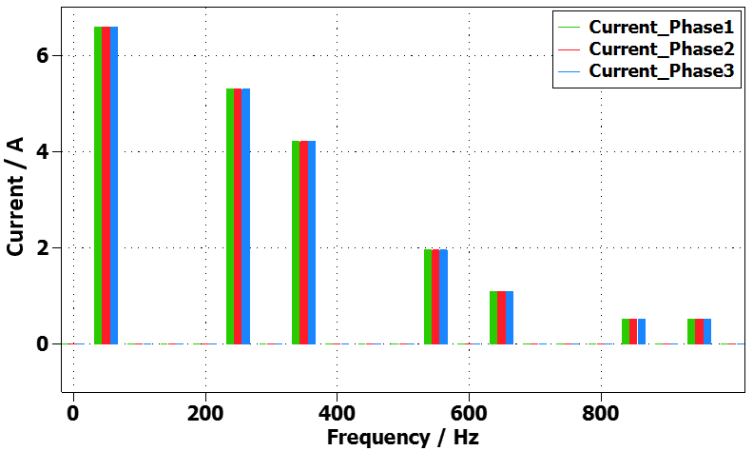
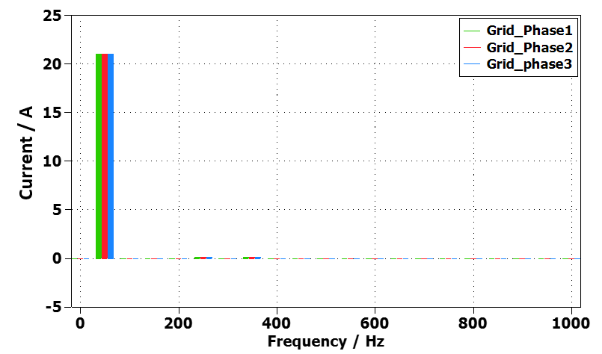
Stretch goal: STATCOM with non-linear load
Harmonics compensation verification
(Before STATCOM is connected)
(After STATCOM is connected)

Slide 23
Thank you!

